Slide 1

AF X-TRIM SERVICES INC.
BANAWA - CORONEL - PARAYNO

Slide 2

COMPANY BACKGROUND
Antonio & Alfonso Facuri & Family decided to venture in their own enterprise- AF X-trim Services Inc.
In 2005, with a complete set of power tools, pest/termite management equipment and a set of computers, AF X-trim began to service houses of friends and relatives.
TODAY, XTRIM has been protecting approximately 250,000 square meters of residential and business structural investments against termites and other pests.
Notes:
MUST REVISE THIS

Slide 3
SERVICES
Household Pest Control
Termite Management
General Services (Construction, Paint, Etc.)

Slide 4
ORGANIZATIONAL CHART

Slide 5
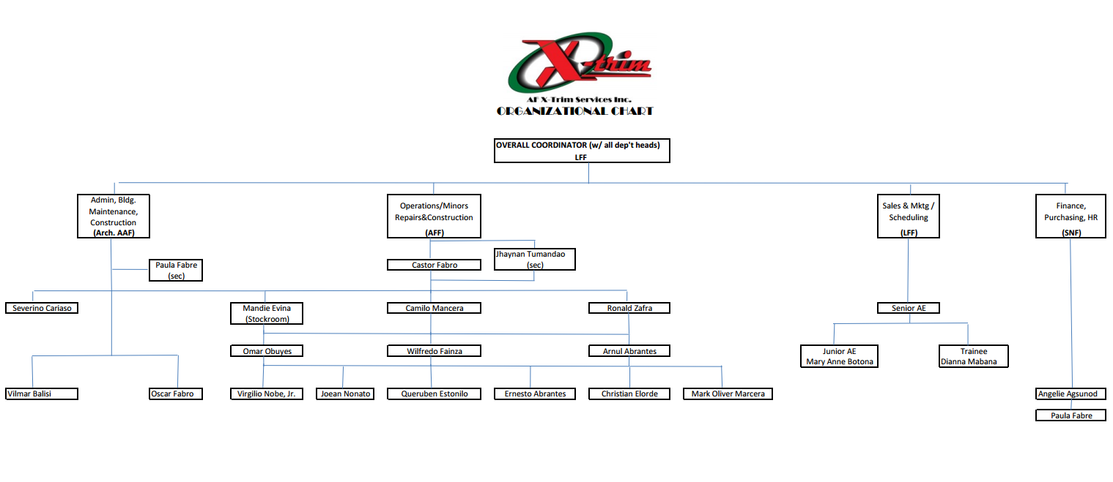

Slide 6


Slide 7


Slide 8
BUSINESS PROCESS

Slide 9
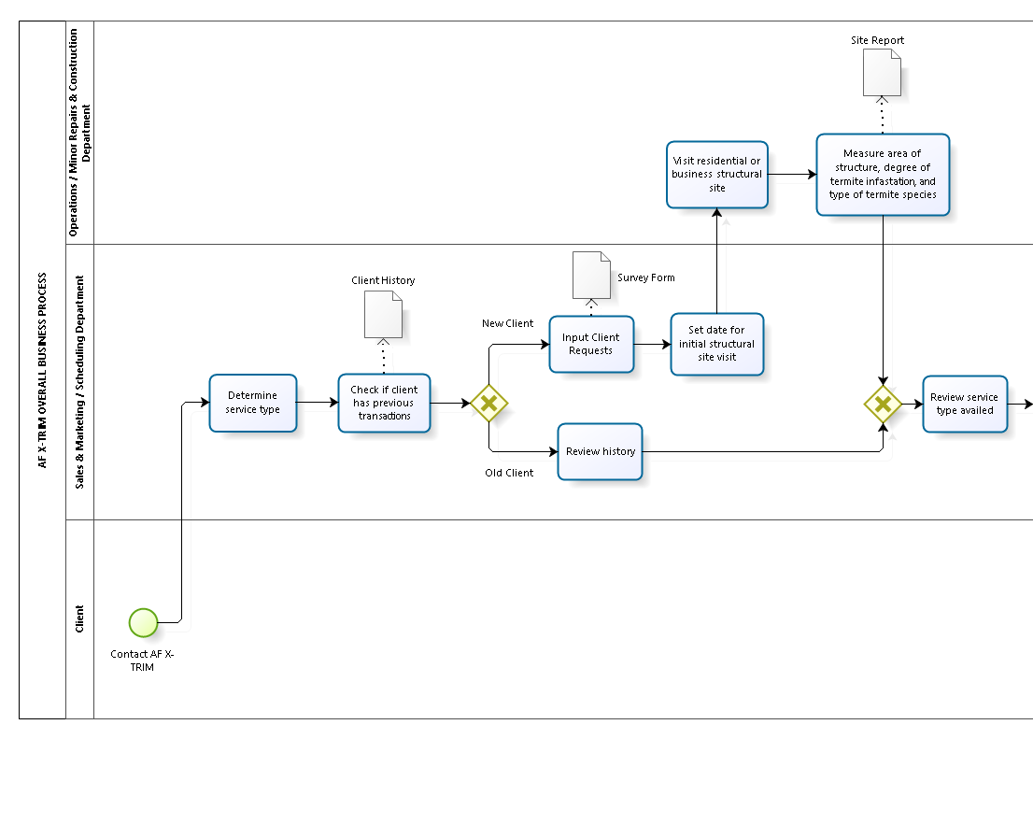

Slide 10
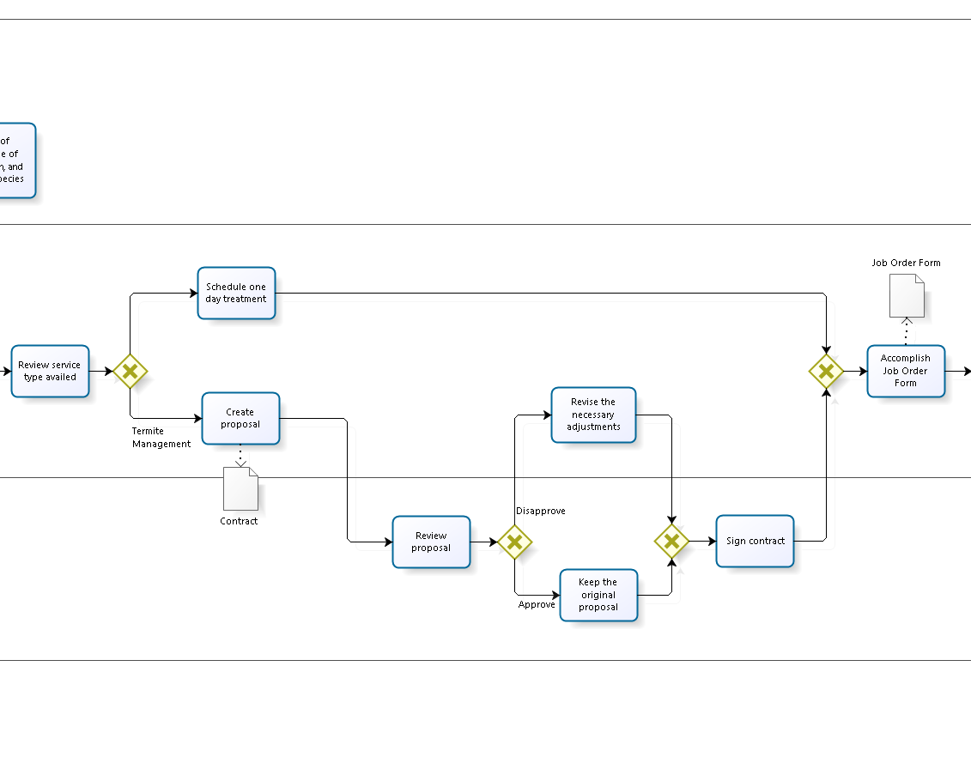

Slide 11
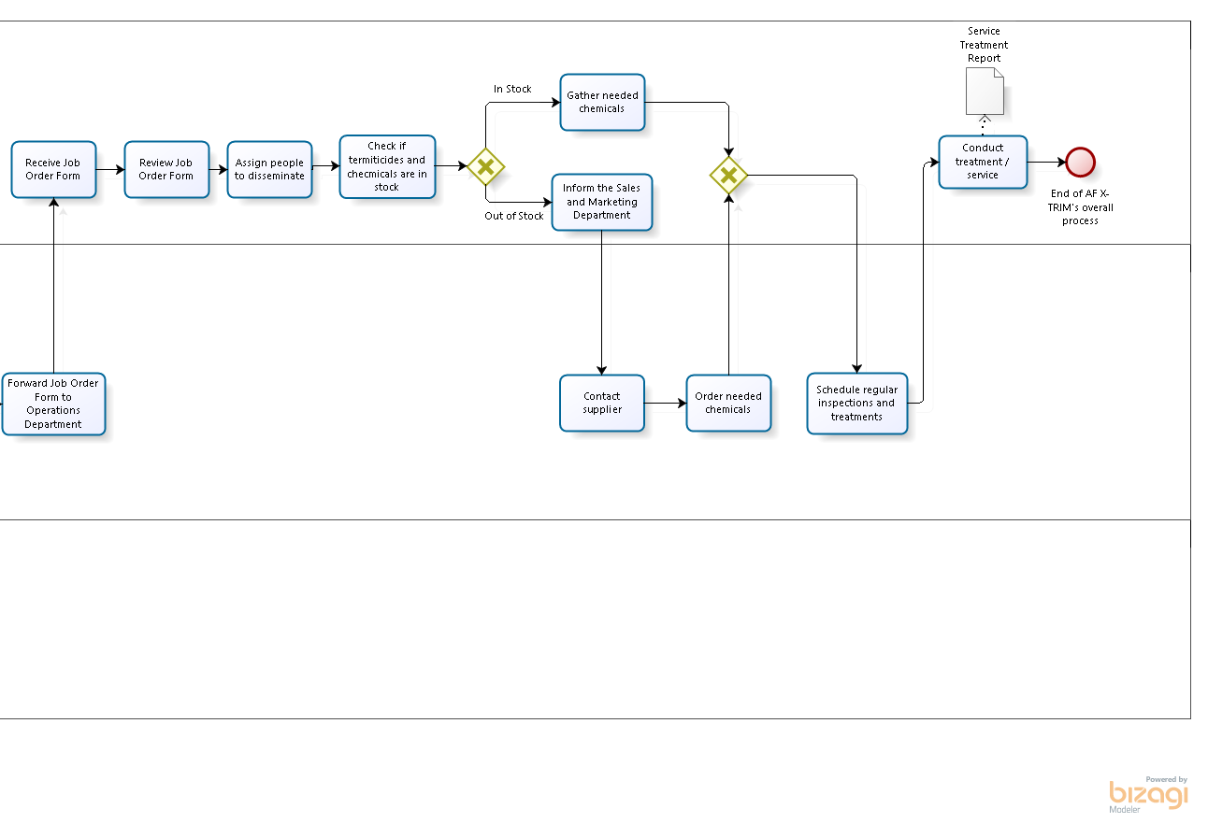

Slide 12
CURRENT PROCESS

Slide 13
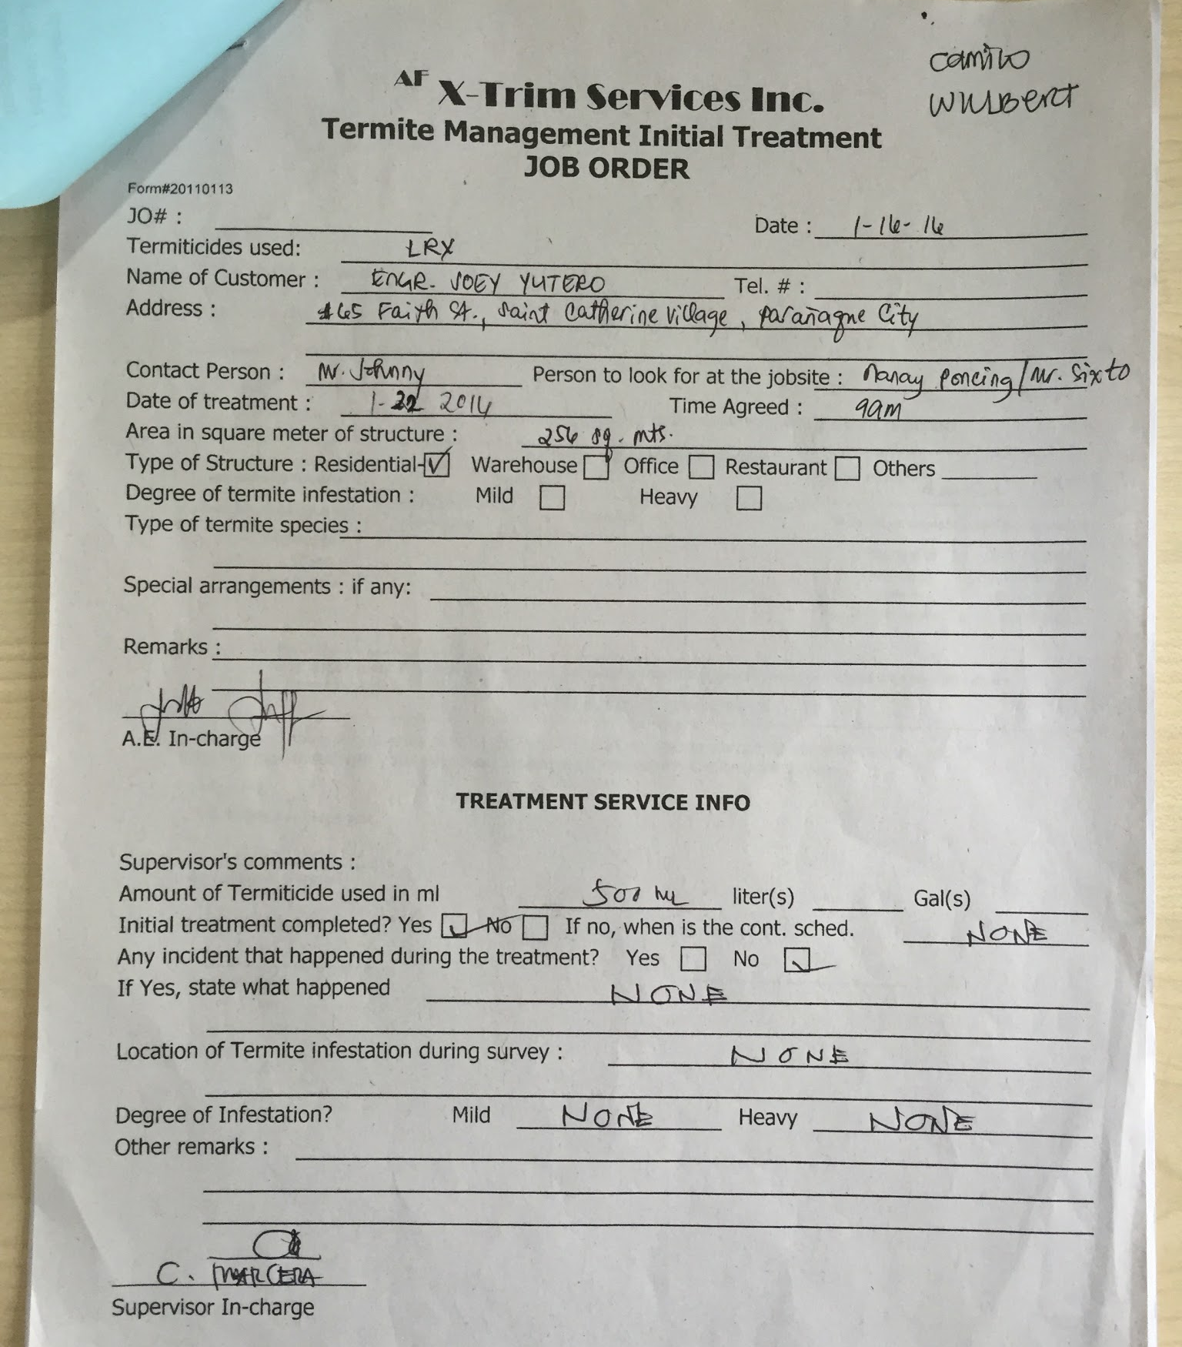
JOB ORDER FORM

Slide 14
EMPLOYEE ASSIGNMENTS

Slide 15
CURRENT SCHEDULING SYSTEM

Slide 16
CURRENT SCHEDULING SYSTEM

Slide 17
CLIENT PROFILE - SERVICE PERFORMANCE

Slide 18
CLIENT PROFILE - SERVICE PERFORMANCE

Slide 19
PROBLEM AREAS

Slide 20
PROBLEM AREAS
MANPOWER
METHOD
-inefficient handling of files and reports
-untimely scheduling input which causes unattended services
-employees not from the Sales and
Marketing Department receive client calls
-employees miss some services
DELAY IN ATTENDING TO SERVICES AND CLIENT REQUESTS
MATERIAL
MACHINE
redundant forms
inconsistent data entries
unsynchronized calendar data
disorganized files

Slide 21
PROBLEM AREAS
Ununified customer schedules/calendars
Weak interdepartmental communication
No document backups
Difficulty looking at past records due to the large collection of files accumulated throughout the 12 years of operation

Slide 22
THE PROPOSED SYSTEM

Slide 23
HIVE
Resource Management System

Slide 24
Thanks!
Questions?

